Slide 1








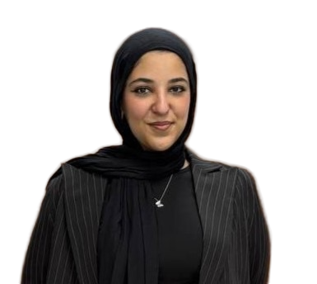


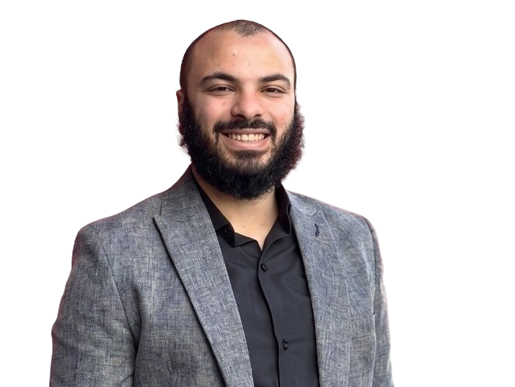

Masarak – The Egyptian Virtual School
Damanhour
Problem Statments
Project Overview
Revenue Model
Egyptian students abroad struggle to access the Egyptian curriculum.
Limited preparation for Egyptian Embassy Exams.
Difficulty tracking student progress remotely.
Lack of personalized learning experience.
Parents need continuous monitoring of their children's performance.
AI-powered learning platform.
Primary, Preparatory & Secondary stages.
Interactive lessons, quizzes & exams.
Personalized AI learning.
Parent progress dashboard.
Monthly & Annual Subscription Plans. Premium AI Features. School & Educational Institution Licenses.
Target Customers
Technologies
Egyptian students abroad.
Parents.
Egyptian schools abroad.
Embassy exam candidates.
AI- Semantic Kernel | Qdrant(RAG)
Backend: ASP.NET Core | EF Core | SQL Server | JWT
Frontend: Angular | TypeScript | Bootstrap | SCSS
Supervised by: Eng. Omnia Elsheikh
Alaa
Walid
Riham Mohammed
Habiba Mohammed
Ahmed Mahran
Amr
Tarik
Ahmed
Ghanem
Notes:
0.

